Slide 1

MATH 5470 Final Project Presentation
Traffic Network Imputation and Congestion Recognition via Attentive Graph Neural Processes
Group member: | DI Yining | 20789913
 | DING Hongxing | 20807820
 | XU Meng | 20636855
Department of Civil and Environmental Engineering, HKUST
2 May 2022

Slide 2
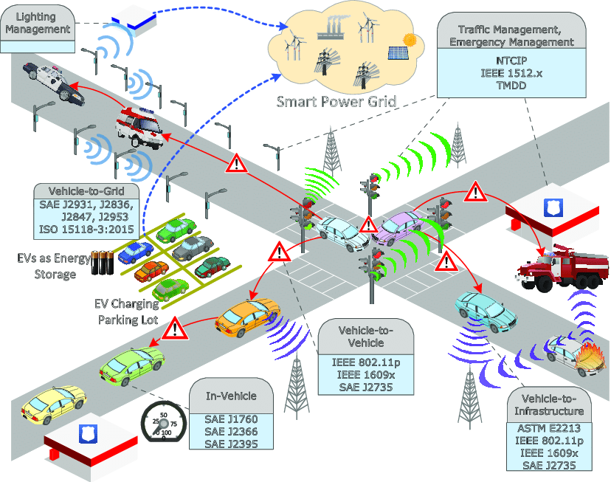
Introduction
improves traffic mobility by incorporating various technological devices into vehicles and road infrastructure
encounters the problem of missing data (e.g., limited cover of intelligent devices, sensor failure)
Intelligent Transportation System (ITS)
Figure source: Yilmaz, Yasin & Uludag, Suleyman & Dilek, Esma & Ayozen, Yunus. (2016). A Preliminary Work on Predicting Travel Times and Optimal Routes Using Istanbul’s Real Traffic Data.

Slide 3
Introduction
Traffic data imputation
Temporal pattern-based imputation: ARIMA
Spatiotemporal pattern-based imputation: KPPCA, DEEP NETWORK
Data imputation + Traffic prediction
Current studies
graph Markov network (Cui et al. (2020))
graph convolutional bidirectional recurrent NN (Zhang et al. (2021))
…
Graph-based deep learning
graph convolution operation
graph-structured traffic data + temporal dependency transformer model
simple temporal convolution (Lee and Rhee, 2022; Zhu et al., 2022)
gated temporal convolution layers (Ta et al., 2022; Yu et al., 2017)
LSTM (Peng et al., 2021)
attention-based encoder/decoder networks (Huang et al., 2022)

Slide 4
Motivation
Research gap:
Previous methods focus on the traffic prediction and data imputation but ignore the reliability analysis on the predicted/imputed values.
Reliability analysis is important for the decision-making in ITSs while the existing data-driven techniques often fall short of traffic prediction/imputation accuracy in the cases with small or noisy datasets, such as short-term prediction.
Gaussian process (GP)
an alternative to address the issue of reliability in traffic prediction/imputation
provide closed-form expressions of the posterior distribution

Slide 5
Motivation
The key in GPs: identify the mean and covariance function $⇒$ can be computationally expensive
Neural process (NP) (Garnelo et al. (2018))
--- maintains the properties of GPs to model distribution over functions and to estimate uncertainties over predictions
--- computationally efficient by combining with the neural network
Attentive neural process (ANP) (Kim et al. (2019))
--- introduces the attention mechanism where a weighted aggregation is conducted on the context representations
--- improves the training efficiency of NP

Slide 6
Objective
Incorporate neural processes into the graph neural network framework and proposes an attentive graph neural process (AGNP) method for short-term traffic network imputation
identify the spatiotemporal patterns of the traffic data
model the traffic data as a stochastic process which the AGNP will further learn
give the congestion probability on the remaining road segments based on observed traffic state information on arterial highways

Slide 7
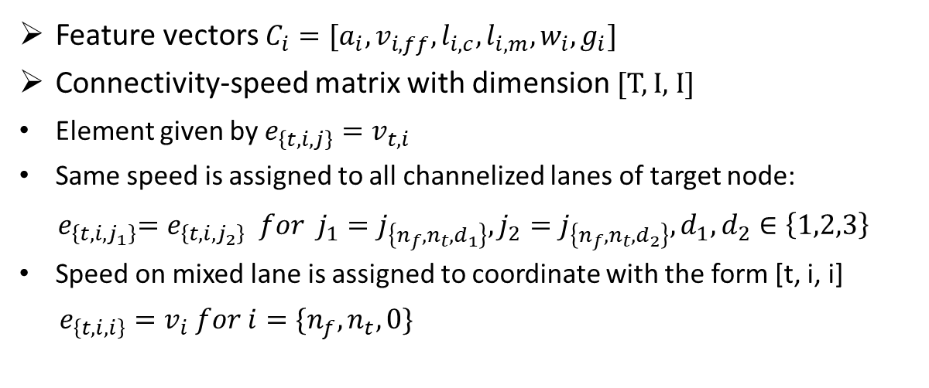
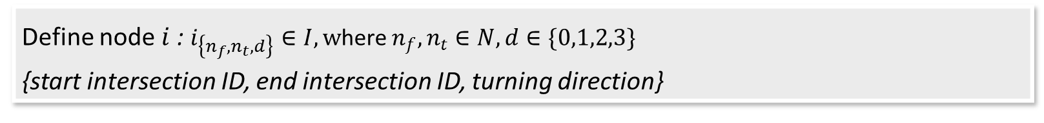
Problem Formulation
Define node $i$: $i_{\left\{n_{f},n_{t},d\right\}}∈I, w$here $n_{f},n_{t}∈N,d∈\{0,1,2,3\}$
{start intersection ID, end intersection ID, turning direction}
Road Section B
Feature vectors $C_{i}=[a_{i},v_{i,ff},l_{i,c},l_{i,m},w_{i},g_{i}]$
Connectivity-speed matrix with dimension [T, I, I]
Element given by $e_{\left\{t,i,j\right\}}=v_{t,i}$
Same speed is assigned to all channelized lanes of target node:
$${ e}_{\left\{t,i,j_{1}\right\}}=e_{\left\{t,i,j_{2}\right\}} for j_{1}=j_{\left\{n_{f},n_{t},d_{1}\right\}},j_{2}=j_{\left\{n_{f},n_{t},d_{2}\right\}},d_{1},d_{2}∈\left\{1,2,3\right\}$$
Speed on mixed lane is assigned to coordinate with the form [t, i, i]
$e_{\left\{t,i,i\right\}}=v_{i} for i=\{n_{f},n_{t},0\}$
End Intersection
Target Intersection
channelized zone
Road Section A
mixed zone
Start Intersection

Slide 8
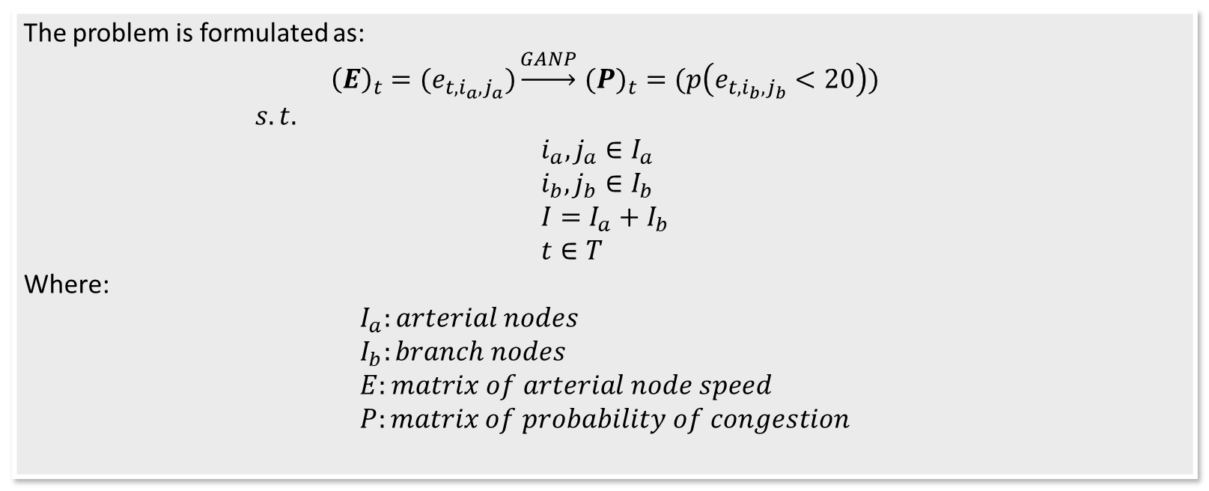
Problem Formulation
The problem is formulated as:
$${\left(E\right)}_{t}={(e}_{t,i_{a},j_{a}})\underset{→}{GANP}({P)}_{t}=(p\left(e_{t,i_{b},j_{b}}<20\right))$$
$s.t.$
$$i_{a},j_{a}∈I_{a} \\ i_{b},j_{b}∈I_{b} \\ I=I_{a}+I_{b} \\ t∈T$$
Where:
$$I_{a}:arterial nodes \\ I_{b}:branch nodes \\ E:matrix of arterial node speed \\ P:matrix of probability of congestion$$
The connectivity matrix is divided into T layers on timestamp dimension. Road network at a given timestamp t is given as a directed network $G_{t}=\left(I,C,{\left(E\right)}_{t}\right)$

Slide 9
Data Acquisition
Raw dataset from central urban area of Xuancheng, Anhui, China, with 374 valid road sections and 1196 valid lanes.
Road Section B
Data Entry:
End Intersection
Intersection ID of start and end of the road section
Target intersection ID of the turning, and turning direction
Free-flow speed, length of mixed zone and channelized zone of road sections
Lane number, turn rate, green time ratio of lanes
Flow and average speed of lanes recorded in a 5-min interval (Totally 5220 timestamps)
Target Intersection
channelized zone
Road Section A
mixed zone
Start Intersection

Slide 10
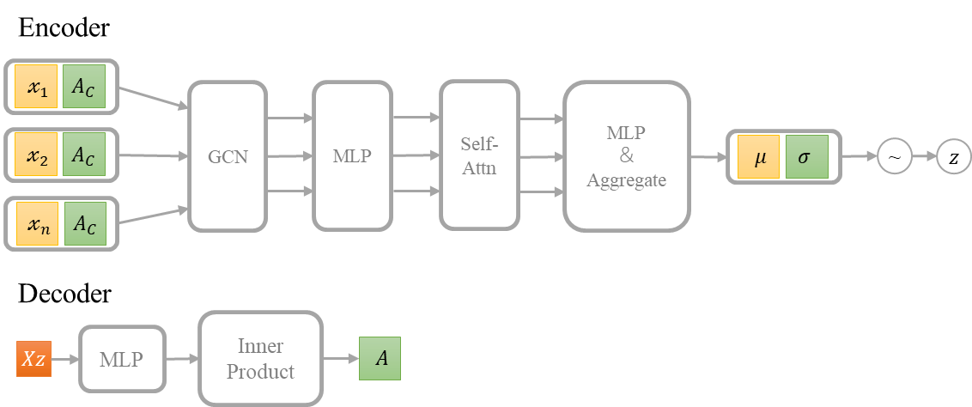
Architecture
The architecture follows an encoder-decoder framework.

Slide 11
Results
1196 nodes, 2241 node features and 1563 valid links at any given timestamp
Matrices: AUC and AP
10 times with different seeds and take the mean for evaluation.

Slide 12
Conclusion
Monitoring systems can never cover every road
Limited budget issues and privacy concerns
Traffic network imputation is of great importance for transportation systems
treat the traffic speed state on arterial highways as a stochastic process
Conducting predictions and reliability analysis and providing confidence
Real-world traffic speed states collected in Xuancheng, Anhui, China, is utilized

Slide 13
Future works
The temporal dependency of the transportation networks is dismissed
Simultaneously consider spatiotemporal correlations.
Short-term predictions which is sometimes unrealistic in real-world
Not always possible to obtain data statistics in such a short time
Design a long-term model; summarize the information of past few hours and predict traffic states in the long term.
The reliability analysis experiments is unfinished
finding an appropriate method to illustrate the convenience and promising values

